Slide 1
UNIT – FIVE
PART-TWO

Slide 2
Developing a quality workforce
Socialisation is the process of influencing the expectations, behaviour and attitudes of a new employee in a way considered desirable by the organisation. The intent of socialisation in HRM is to help achieve the best possible fit between the individual, the job and the organisation.

Slide 3
Employee orientation
Socialisation of newcomers begins with orientation — a set of activities designed to familiarise new employees with their jobs, co‐workers and key aspects of the organisation as a whole. This includes clarifying the mission and culture, explaining operating objectives and job expectations, communicating policies and procedures, and identifying key personnel.

Slide 4
Training and development
Training is a set of activities that provide the opportunity to acquire and improve job‐related skills. This applies both to the initial training of an employee and to upgrading or improving someone’s skills to meet changing job requirements.
These concerns even extend to the basic skills of reading, writing and arithmetic, as well as to computer skills. Progressive organisations offer extensive training programs to ensure that their workers always have the skills and computer literacy needed to perform well.

Slide 5
On‐the‐job training
Coaching, in which an experienced person provides performance advice to someone else.
One form of coaching is mentoring, in which employees at the early stages of their careers are formally assigned as protégés of senior people. The mentoring relationship gives them regular access to advice on developing skills and getting a good start in their careers
. An informal type of coaching involves modelling. This occurs when someone demonstrates through day‐to‐day personal behaviour what is expected of others.

Slide 6
Off‐the‐job training
An important form of off‐thejob training involves management development, designed to improve a person’s knowledge and skill in the fundamentals of management. For example, beginning managers often benefit from training that emphasises delegating duties; middle managers may benefit from training to better understand multifunctional viewpoints; top managers may benefit from advanced management training to sharpen their decision‐making and negotiating skills and to expand their awareness of corporate strategy and direction.

Slide 7
Performance management system
Ensures that performance standards and objectives are set, that performance is regularly assessed for accomplishments, and that actions are taken to improve performance potential in the future.

Slide 8
Purpose of performance appraisal
Performance appraisal. It serves two basic purposes in the maintenance of a quality workforce: evaluation and development.
The evaluation purpose is intended to let people know where they stand relative to performance objectives and standards.
The development purpose is intended to assist in their training and continued personal development.
Judgemental role in which he or she gives a direct evaluation of another person’s accomplishments.
Counselling role, focusing on a subordinate’s developmental needs. Like employment tests, any performance appraisal method can fulfil these purposes only when the criteria of reliability and validity are met.
Written documentation of performance appraisals and a record of consistent past actions will be required to back up any contested evaluations.

Slide 9
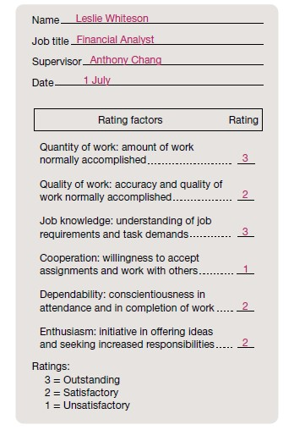
Performance appraisal methods

Slide 10
Behaviourally anchored rating scale
(BARS), which offers an appraiser rating scales for actual behaviours that exemplify various levels of performance achievement in a job.
The critical‐incident technique involves keeping a running log or inventory of effective and ineffective job behaviours. By creating a written record of positive and negative performance examples, this method documents success or failure patterns that can be specifically discussed with the individual.

Slide 11
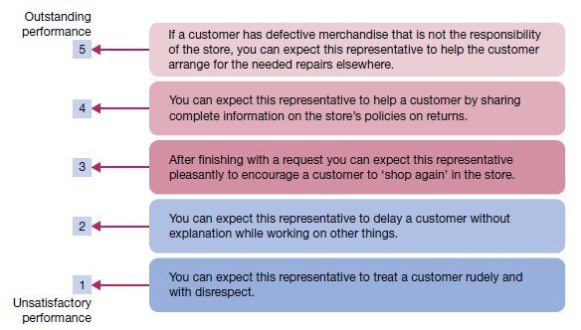
Sample Behaviourally anchored rating scale for performance appraisal

Slide 12
Multiperson comparisons, which formally compare one person’s performance with that of one or more others. Such comparisons can be used on their own or in combination with some other method.
In rank ordering, all people being rated are arranged in order of performance achievement.
In paired comparisons, each person is compared with every other person and rated as either the superior or the weaker member of the pair.
In forced distribution, each person is placed into a frequency distribution that requires that a certain percentage fall into specific performance classifications, such as top 10 per cent,

Slide 13
Peer appraisal, including in the process others who work regularly and directly with a job holder, and upward appraisal, including in the process subordinates reporting to the job holder.
An even broader stakeholder approach is known as 360° feedback, where superiors, subordinates, peers and even internal and external customers are involved in the appraisal of a job holder’s performance.

Slide 14
Strategic capabilities are difficult to imitate, are of value to the customer, and are better than those possessed by the majority of competitors.
Dynamic capabilities are physical (e.g. state‐of‐the‐art equipment or advantageous location), organisational (e.g. an outstanding sales force) and human (e.g. expertise in a specialised field).

Slide 15
Competitive advantage. This term refers to the use of a core competency that clearly sets an organisation apart from its competitors and gives it an advantage over them in the marketplace. Simply put, competitive advantage comes from an ability to do things better than your competitors. An organisation may achieve competitive advantage in many ways, including through its products, pricing, customer service, cost efficiency, quality, and even diversity, among other aspects of operating excellence.

Slide 16
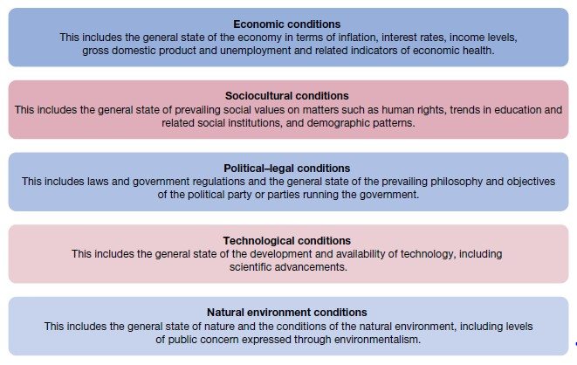
Major elements of an organisation’s general environment

